Slide 1
User Cases
Group 7 - Habit Tracker

Slide 2
Members
Joe Lebedev
Zachary Tobey
Shanyu Juneja
Trung Dang
Manager: Srihari Srivatsa

Slide 3
Overview
Habit Tracker provides a convenient, interactive, and safe way to track your habits and share them with your friends. The app allows you to create your own habits or subscribe to an existing one. You can also customize your intensity. Every time you perform a habit, you can quickly check it off on the main page and share your achievements with your friends. We also provide private habit options, which will be hidden from other users.

Slide 4
Use Case - User Accounts
Signing up a new account
Goal | User can sign up for a new account
Actors | User
Trigger | User selects Sign Up button
Success Condition | User has not created an account before, the sign-up email is valid
Main success scenario | User goes to the login page. User clicks the sign up button. User enter the username, email, and password. System check if the username and email has existed, if not, create new account. Server creates a new account.
Error Scenarios | 3a. Username contains non-alphanumeric characters. 3b. Invalid email address (not of type <user>@<email_provider>.com). 4a. Username taken or account with that email already exists.

Slide 5
Use Case - User Accounts
Signing into an existing account
Goal | User can log in to their account
Actors | User
Trigger | User selects Sign In button
Success Condition | User has created account and authentication info is valid
Main success scenario | User goes to the login page. User click the sign in button. User enter the username or email, and password. Server checks if the data is correct, if so User is logged in.
Error Scenarios | 3a. Username or account with input email do not exist. 3b. Username and email exist, but password is incorrect.

Slide 6
Use Case - Setting up Habits
Adding a new habit to your schedule
Goal | User can add a new habit to their schedule or subscribe to an existing habit
Actors | User
Trigger | User select the “+” button in their habit list
Success Condition | User is logged in, if subscribing to a friend’s habit, habit must not be private
Main success scenario | User is signed in. User goes to “Home page” and hit the “+” button. User inputs the habit name or subscribes to a habit (two options, there is a list of existing most common habits and another list of your friends’ habits). User selects the frequency for the habit (days a week). User presses “create new habit”. System adds the habit to user’s list, calendar, etc.
Error Scenarios | 1a. User is not signed in. 3a. The habit name is not alphanumeric. 3b. The habit user trying to subscribe to does not exists or is private. 4a. Frequency is invalid (more than 7 days a week, < 0, etc.).

Slide 7
Use Case - Checking Off Habits
Checking off completed habits from main page
Goal | User can check off a “circle”, indicating that they have completed their habit for the day
Actors | User
Trigger | User selects a habit and checks it off for the day
Success Condition | User is logged in, the habit must exist
Main success scenario | User is signed in. User goes to “Main page” where they can see all their habits with check in “circles” below them. Server will return the habit data to the User. User hits the “circle” button for the day. The server will increment the number of days User has completed this habit.
Error Scenarios | 1a. User is not signed in. Error message will be displayed and user prompted to sign in. 2a. No habits created. 4a. The user has already Completed this habit for the day. 2 ways to handle this exception would be: display an error message or hide the “Completed” button once it is clicked.

Slide 8
Use Case - Deleting Habits
Deleting habits
Goal | User can delete habits they no longer want to keep doing
Actors | User
Trigger | User long presses on a habit
Success Condition | User is logged in, the habit must exist
Main success scenario | User is signed in. User goes to “Main page” where they can see all their habits. Server will return the habit data to the User. User presses on a habit for a few seconds. A “delete the habit” option pops up below the habit. User presses the button. The server removes the habit from “Main page” and any data related to it.
Error Scenarios | 1a. User is not signed in. Error message will be displayed and user prompted to sign in. 2a. No habits created.

Slide 9
Use Case - Calendar for Habits
Viewing Habits as Calendar
Goal | User can view the habits in the form of a calendar
Actors | User
Trigger | User select the calendar icon in the app
Success Condition | User is logged in
Main success scenario | User signs in and go to the “Calendar” page of the app. Server query all the habit data within the last month and return the report for user. User can see a mini calendar for each habit in a list. User can press on each mini calendar if they want data for more than the last month.
Error Scenarios | 1a. User is not signed in. 2a. The user has just signed up, so there is no data and therefore the server will return null. On receiving null, the app should display an empty calendar.

Slide 10
Use Case - Friend’s Lists
Adding friends with other users on the platform and viewing their habits
Goal | User can add friends with others and view their habits
Actors | User A, User B
Trigger | User A go to User B’s profile and hit the “Add friend” button
Success Condition | User A must be logged in, User B profile must exist
Main success scenario | User A is signed in. User A searches for User B by name or username on the search bar. Server returns User B profile, after which User A hits the “Add friend” button. Server records this event and notifies User B. User B accepts User A request. Server logs User A and User B as friends. User A opens their friend list. Server returns User B’s habits among other friends User A might have added earlier and they are shown in a list under each friend.
Error Scenarios | 1a. User is not signed in. Error message will be displayed and user prompted to sign in. 2a. User B does not exist or contains special characters from other languages. 5a. User B does not accept User A request, after which the event will be discarded on the server, and User A will not receive a message.

Slide 11
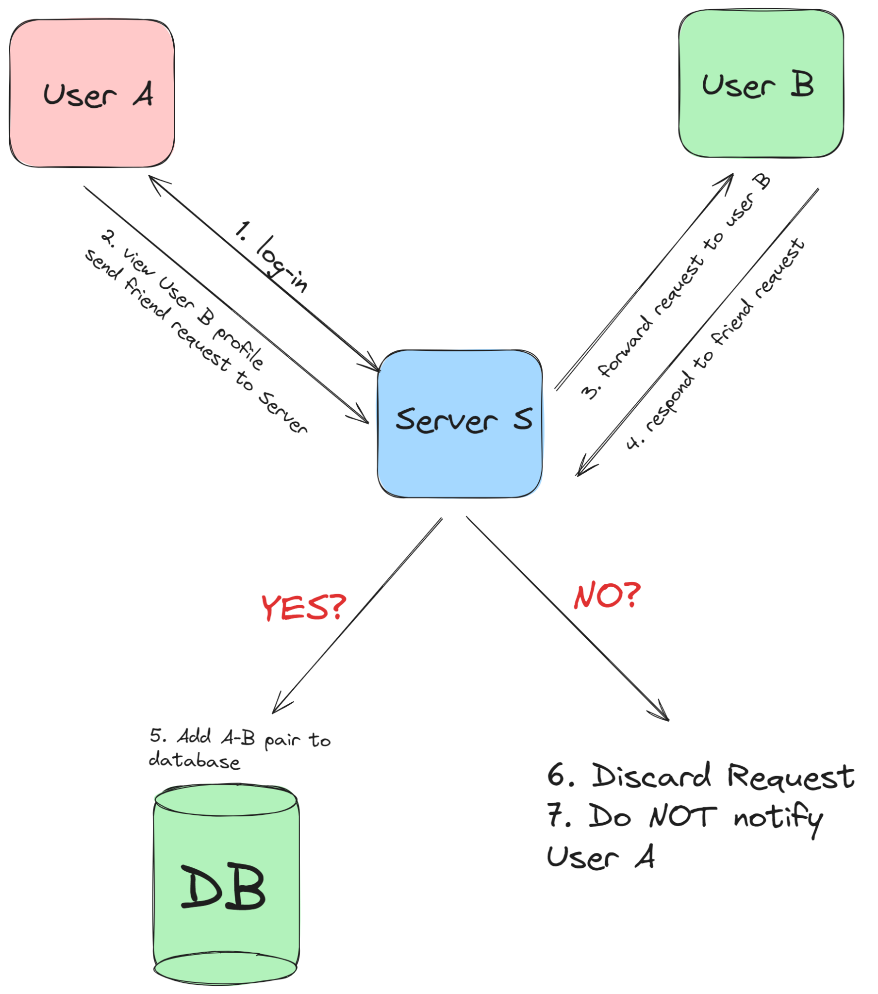
Use Case - Friend’s Lists
Adding friends with other users on the platform and viewing their habits

Slide 12
Use Case - Weekly Summary
Provide User with a weekly Summary of the Week
Goal | User can view the weekly summary of their habits
Actors | User, Server
Trigger | End of Week triggers runner to generate a report for the week
Success Condition | User has created and added some habits
Main success scenario | A Worker Server is triggered at the end of the week. Server collects data from all users, runs algorithm to generate report, and stores it in database. Server notifies User that the report is generated (either via notification or a textbox). User logs in to their profile and sees the message, hits the “report” button to view. Server query the database to get the report, and show to the User.
Error Scenarios | 4a. User is not signed in, or it is their first week so no report available. 5a. No report generated for this user. (database error) Either display error message or show “generate report” option. 5b. No habits were completed during the week, in which case the server can show an encouraging message.

Slide 13
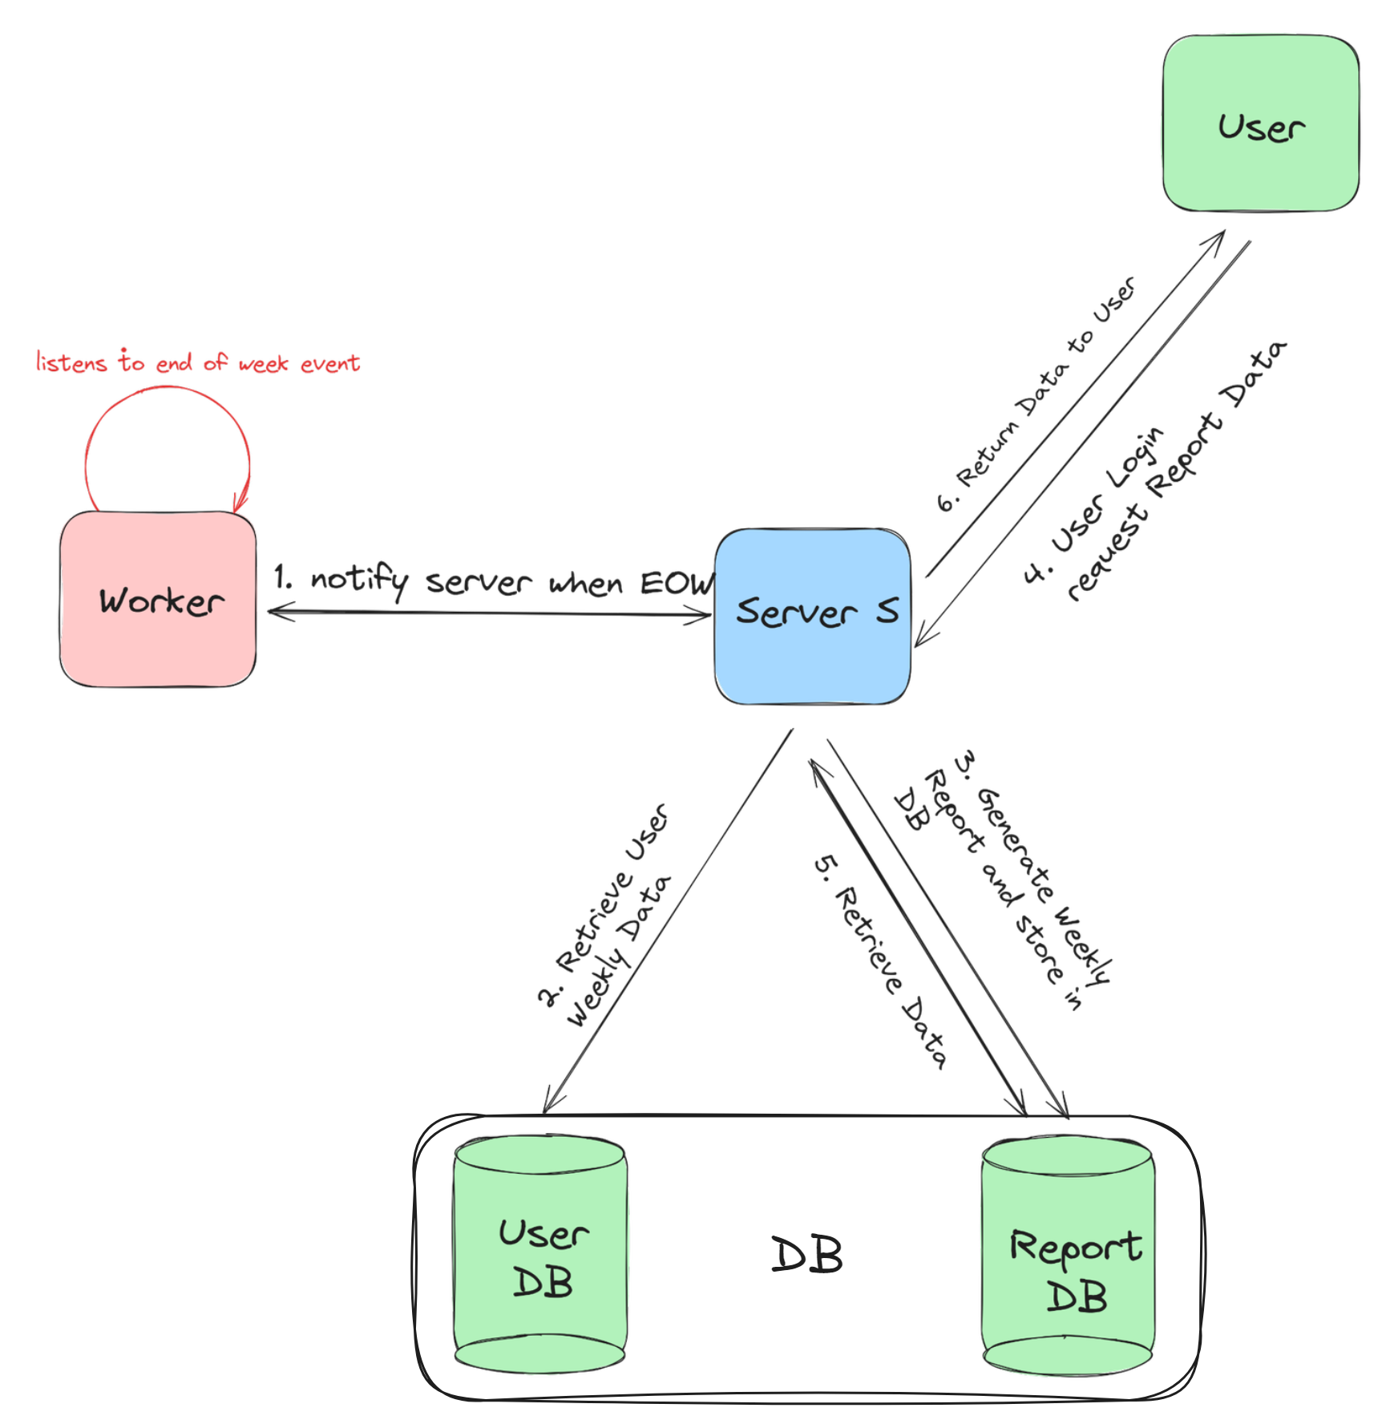
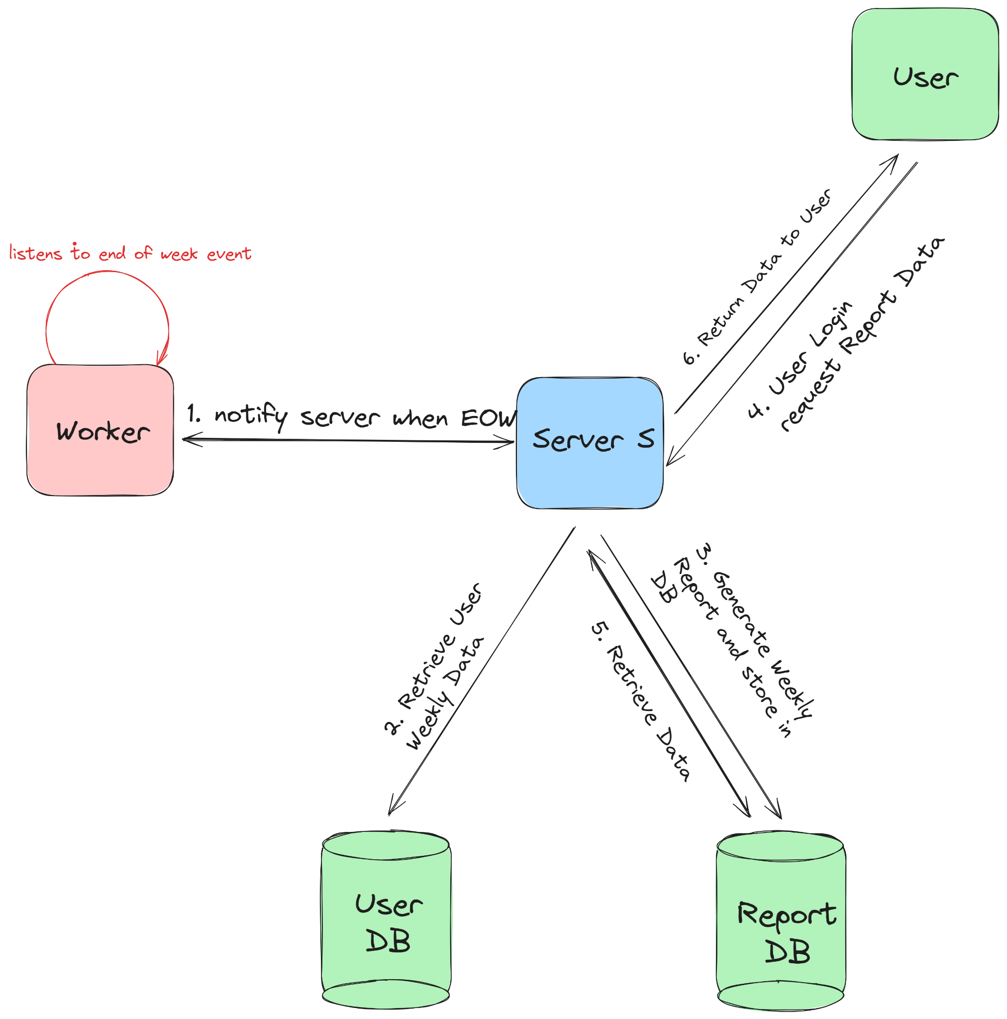
Use Case - Weekly Summary
Provide User with a weekly Summary of the Week
Data
Data

Slide 14
Use Case - Settings page
Editing which of your Habits you want to be Private
Goal | User can hide habits from being seen by their friends
Actors | User A, User B
Trigger | User A taps on the settings button
Success Condition | User A must be logged in and have habits created
Main success scenario | User A is signed in. User A goes to the settings tab. Server returns a list of the habits with a toggle next to them. User presses on the toggles next to habits they want to be private. Server records the preference for each habit. User B (user A’s friend) opens their friend list. Only non-private habits are now visible to User B (who is their friend).
Error Scenarios | 1a. User is not signed in. Error message will be displayed and user prompted to sign in. 4a. The habit User A tries to make private does not exist.

